Slide 1

Lecture 4
Scanning and Pen-Test Network Perimeter Devices
Ethical Hacking
Diploma in CSF
Year 3 (2021/22), Semester 5
Notes:
Left-hand Bar – Replace FSP by your module code and X by the lecture number.
Replace Lecture Title
Replace < Module Name >
Replace Year and Semester if necessary

Slide 2
Learning Outcomes
At the end of this lecture, the students will be equipped with knowledge and various skills to scan and pen-test network perimeter devices.

Slide 3
Learning Objectives
At the end of this lecture, students will be able to:
Explain the activities in the Scanning Phase;
Explain the concept of network perimeter and network perimeter devices;
Identify entry points into an organization’s network;

Slide 4
Contents
Activities in Scanning Phase
Network Perimeter and Network Perimeter Devices
Scanning for Network Perimeter Devices
Choice of Entry Points
Pen-Test Wireless Router
Methods for obtaining Wireless Network Access through Encryption Keys
Methods for obtaining Wireless Router Access through Web Interface
Methods for obtaining Wireless Router access through Remote Access Services

Slide 5
Pen-Test Network Router
Methods for obtaining Network Router Access through Web Interface
Methods for obtaining Network Router access through Remote Access Services
Pen-Test Network Firewall
Methods for obtaining Network Firewall Access through Web Interface
Methods for obtaining Network Firewall Access through Remote Access Service
Summary

Slide 6
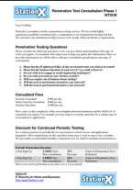
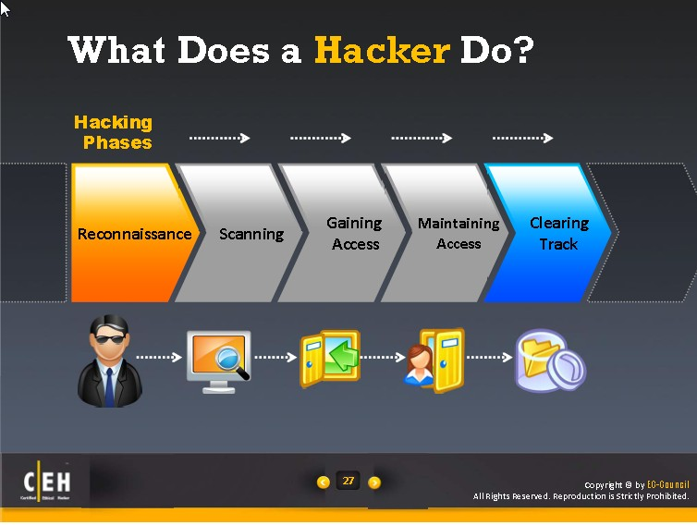
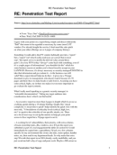
Our Pen-Test Process Model
Planning
Reconnaissance
Scanning
Exploit Systems
Reporting

Slide 7
Activities in Scanning Phase

Slide 8
Activities in Scanning Phase
Scan for Network Perimeter Devices
Determine Entry Points and Connect to Internal Networks
Scan for Internal Network Devices
Mapping of Internet Networks and Devices
Scan for Host Vulnerabilities
In this lecture, we concentrate of perimeter devices.

Slide 9
Network Perimeter and Network Perimeter Devices

Slide 10
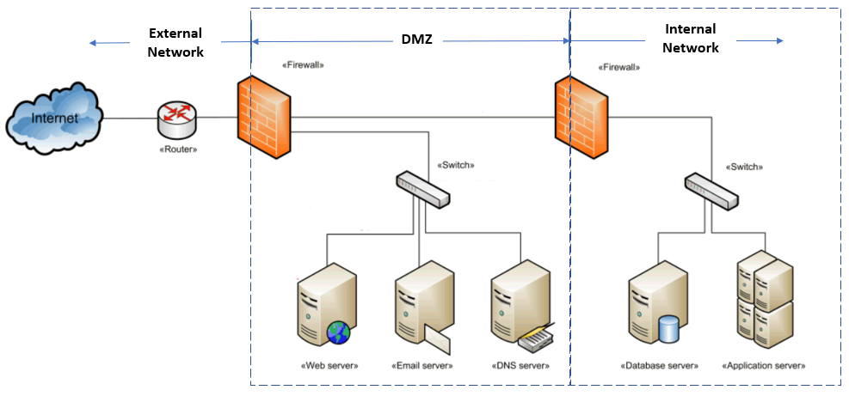
Network Perimeter
A Network Perimeter can be referred to as a secured boundary between the private network, often a company’s internal network, and the public facing side of a network, often the Internet.
In the above network architecture diagram, there is a network perimeter protecting the Internal Network of the target organization. However, there is also another network perimeter defending the devices in the DMZ area

Slide 11
Network Perimeter Devices can be referred to as devices that are exposed to external network and each device has its own Public IP address.
The network security devices in the above example would then be the router and the two firewalls. These devices need to be properly configured to protect the assets in the organization. For the purpose of this lesson, we assume a network infrastructure without other network security devices such as Intrusion Detection System (IDS) and Intrusion Prevention System (IPS).

Slide 12
Scanning for Network Perimeter Devices

Slide 13
Perimeter devices are usually public facing devices. In another word, each of them will make use of a public IP address.
For that matter, there are subjected to attack and each of them can serve as an Entry Point into the network once it is penetrated or by-passed.

Slide 14
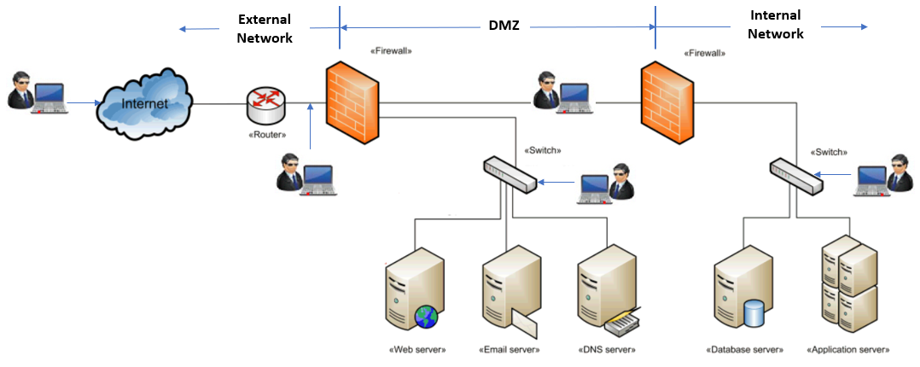
Activity 4.1 - Exploration

Slide 15
What are the network perimeter devices in the architecture diagram in the previous slide will be subjected to attack?
Discuss and answer in class, no submission needed)

Slide 16
Methods for Hunting Down Network Perimeter Devices
Methods for Locating Network Perimeter Devices

Slide 17
Methods for Locating Network Perimeter Devices
All public facing devices can be termed as network perimeter devices. There are many ways to go about looking for these devices and three commonly used methods are as follows:
[1] Request a copy of the Latest Network Architecture Diagram (with Network ID indicated) from the Client
This can be done during the scoping exercise. If the client do not have the latest diagram, just request for any network diagram they have or any past security assessment or pen-test reports. The pen-test team can get a number of network IDs or IP addresses from these documents to work on.

Slide 18
[2] Create a Website and to capture Visitor's IP address
The IP address captured is the router's IP address when the packet leaves the router at the organization.
[3] Ping the Web Sever (Located at Premise)
Before cloud technology gain popularity, organizations place their web server in the DMZ, which make it accessible by anyone from the Internet and staff from the internal network. Same goes for all other servers (e.g. DNS Server, Mail Server etc.) sitting in the DMZ.
These are public facing devices which means they each will have a pubic IP address.

Slide 19
Choice of Entry Points

Slide 20
The choice of which perimeter device to be chosen as entry point depends on the clauses in the Rules of Engagement that stipulate where on the network the pen-testers are allowed to carry out the pen-test.
To-date, many organizations are deploying mobile devices at their work place. This is illustrated in the diagram on the next slide.

Slide 21
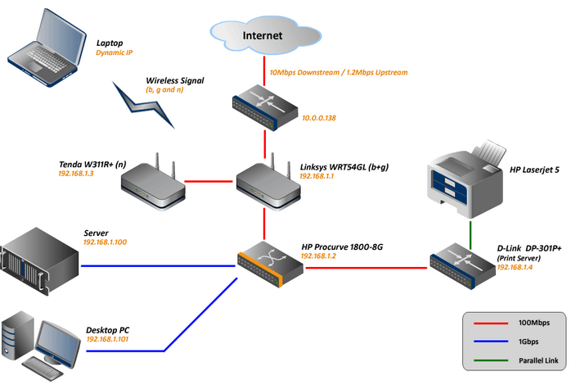

Slide 22
Assuming that it is a Black Hat pen-test project, the obvious choice of entry point to easily get connected to the internal network would be via the wireless APs.
The choice of entry point is similar to those SME/Home User that subscribed to Broadband Service and deployed Wireless Technology in their organization.

Slide 23
Pen-Testing Network Perimeter Devices

Slide 24
Things to Take Note of before You Move On from Here:
[1] We assume that your team has been engaged to pen-test the WoCAT infrastructure which is shown in the next slide. The pen-testers will play the role of the attackers to find ways to penetrate the systems on each of the subnets.
[2] The word "pen-tester" and "attacker" will be inter-used in subsequent texts from time to time.

Slide 25
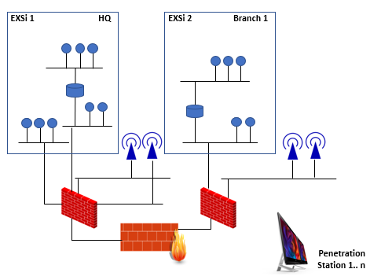

Slide 26
Reasons for Pen-Test Wireless Router
[1] To check access to the Wireless Network through the Encryption Key
With the crack encryption key, the pen-tester can connect to the wireless LAN and attack the hosts in the Internal Network.
[2] To check access to the router OS through the Web Interface
With the cracked login credential, the pen-tester could login and view/change the access configurations and lift the restrictions if needed to.
[3] To check access to the router OS through telnet and ssh.
Often these services are left on by default. The pen-tester could login and make any changes deem necessary to carry out remaining tests.

Slide 27
Methods for obtaining Wireless Connectivity through Encryption Keys

Slide 28
[1] WPS
WPS stands for Wi-Fi Protected Setup and it was designed to make setting a secure AP simpler for the average homeowner.
The WPS PIN could be brute-forced using tools like Reaver.

Slide 29
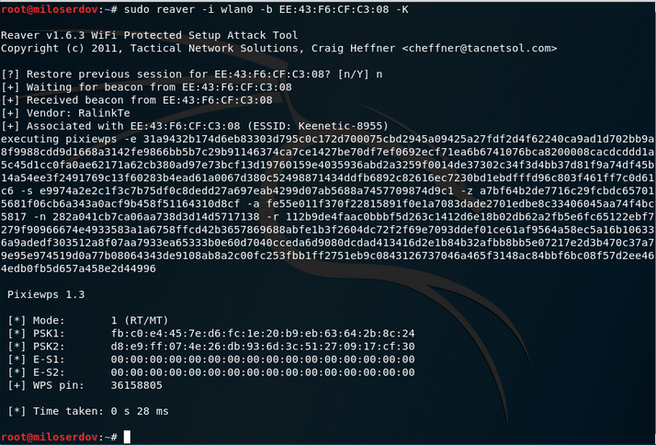

Slide 30
[2] WPA2-PSK
Short for Wi-Fi Protected Access 2 - Pre-Shared Key, and also called WPA2 Personal, it is a method of securing your network using Pre-Shared Key (PSK) authentication method, which was designed for home users.
There are a number of proven ways to crack the encryption key, one of which is a python script called Airgeddon (see this week practical)

Slide 31
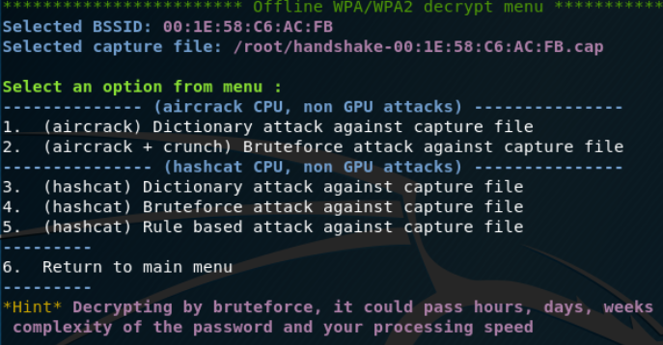

Slide 32
[3] WPA2-Enterprise
WPA2-Enterprise has been around since 2004 and is still considered the gold standard for wireless network security, delivering over-the-air encryption and a high level of security.
The user (supplicant) will be channel to the authtication server for identity verification before it is allowed to connect to the network.
So far, the attacker could only access to such network by using MITM attack to obtain the credential needed to login and connect to the network as presented by Teck_k2.
Example
NPWirelessx

Slide 33
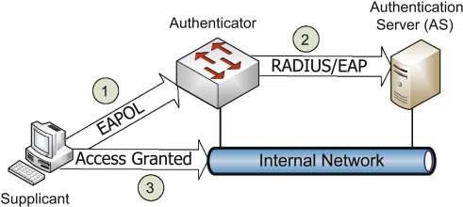

Slide 34
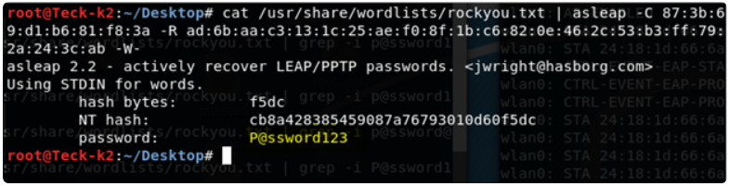

Slide 35
Methods for obtaining Wireless Router Access through Web Interface

Slide 36
A wireless router like one of those used at home provides web interface to allow the owner or administrator to login to configure and maintain the device.
Anyone with physical access can reset the device and use the default ID and password to login in.
These default information can be found on the Internet.

Slide 37
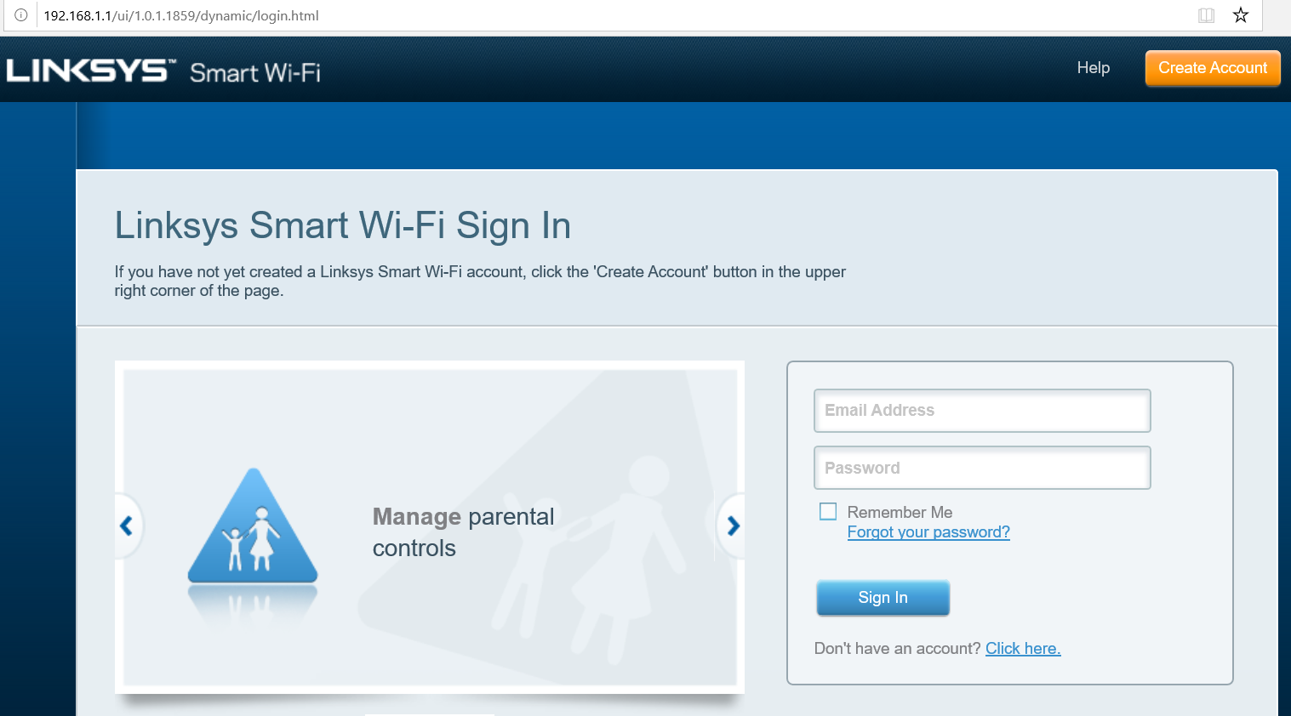

Slide 38
Now imagine that the pen-tester do not have physical access and he is operating form the Internet and he has obtained the public IP address of your router.
The attacker could scan your router from anywhere to check for services that are running on your router. Think Shodan…
They can scan your router to find out what services are running on your router.

Slide 39
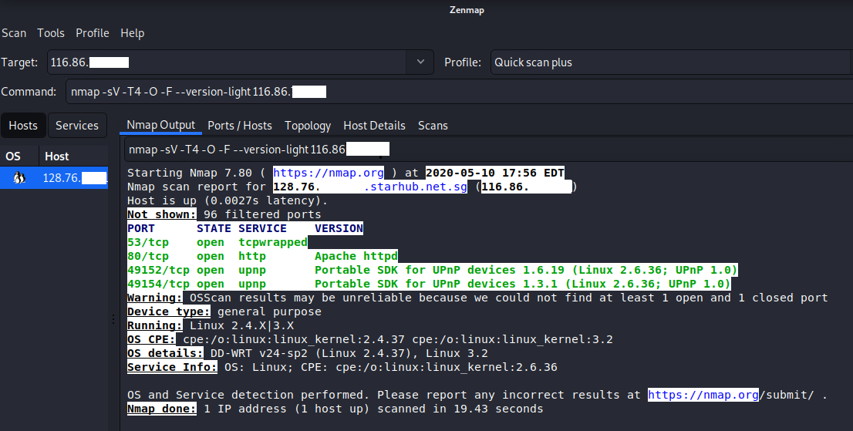

Slide 40
Now that the attacker notice that you have a web server listening at port 80.
He will open up his browser and point to your IP address, and wolah! The same web-page appears.
Now he can either bruit-force or create account (How clever ! )

Slide 41
Activity 4.2 - Exploration
Check out if your wireless router at home suffer the same faith. No submission needed.

Slide 42
Methods for obtaining Wireless Network Router access through Remote Access Services

Slide 43
The following is a simulation on an Debian OS used in the Wireless Router.
A simple scan using zenmap reveals the following open ports as show in the next slide.

Slide 44
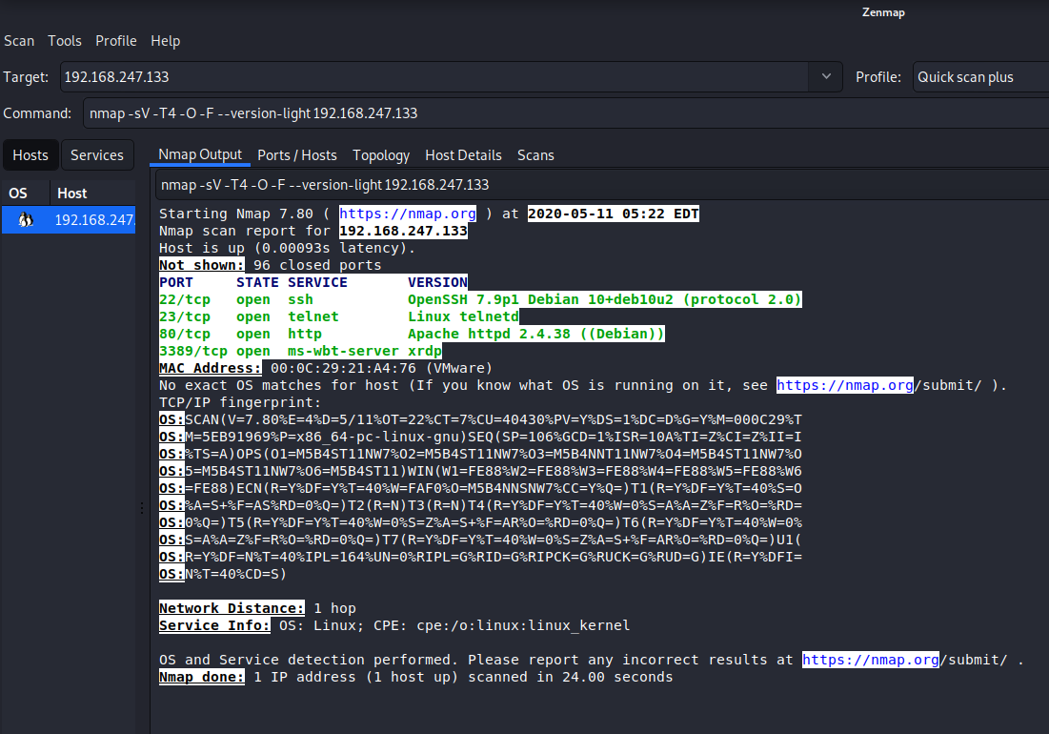

Slide 45
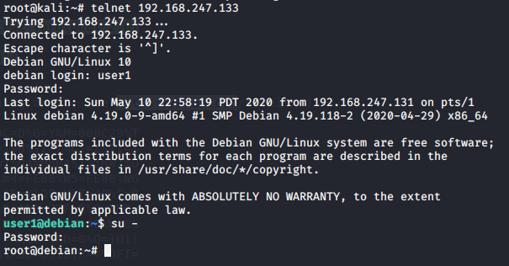
The attacker can telnet into the device via port 23 from anywhere in the world if this is a perimeter device with public IP address.

Slide 46
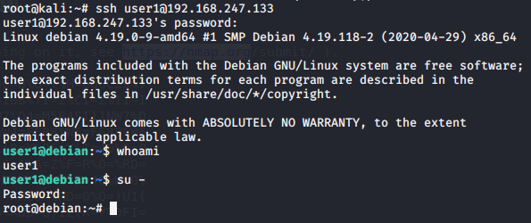
Likewise, attacker could also login to the wireless router using default/social engineered/bruit force credential using SSH protocol via port 22.

Slide 47
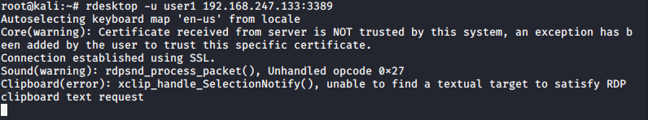
Worse, the attacker could have GUI login in via port 3389 using remote desktop prototcol, rdp with the guessed/social engineered credential.

Slide 48
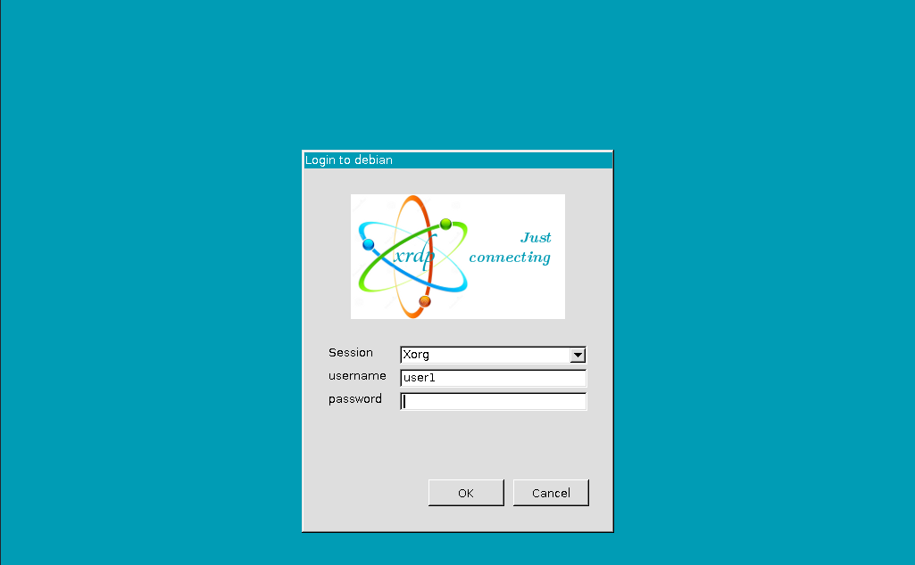

Slide 49
Pen-Test Network Router

Slide 50
Reasons for Pen-Test Network Router
[1] To check access to the router via the Web Interface
Using the normal web interface provided by the router and login to the router, the pen-tester will have information on the network IDs and routing information.
[2] To check access to the router OS through telnet and ssh.
Often these services are left on by default to allow the administrator to remote access into the router to maintain the device. Similar to [1], the pen-tester will gain insight to the internal networks.

Slide 51
Method for obtaining Network Router Access through Web Interface

Slide 52
The problem we have here is the same as the wireless router because most network router also offers a web interface for its user to configure the router.
So one need to scan for port 80 in the target router and thereafter bruit force to login using commonly used ID and password. If all fail, the attacker could make use of dictionary attack using tool like "hydra".

Slide 53
hydra is a password cracking tool, which can perform rapid dictionary attacks against many protocols, including Telnet, RDP, SSH, FTP, HTTP, HTTPS, SMB... It is created by Vanhauser-thc.
The syntax of the command is as follows:
hydra -l <USER> -p <Password> <IP Address> http-post-form “<Login Page>:<Request Body>:<Error Message>”

Slide 54
Using hydra to crack the login credential of a web page requires a bit more research compare to using it for the same purpose using other protocols. You will need the URL of the Login Page, the Request statement and the Error Message.
Follow the video "Brute Force Login Pages using Hydra" by Hackaholic or "Brute Forcing Website Login with Hydra and Burpsuite" by NetSecNow to learn how you can obtain the login credential using THC-hydra.

Slide 55
Methods for obtaining Network Router access through Remote Access Services

Slide 56
The bruit forcing of login credential using hydra for the following protocols is much easier than http protocol.
The usage are shown in the examples in the next three slides.

Slide 57
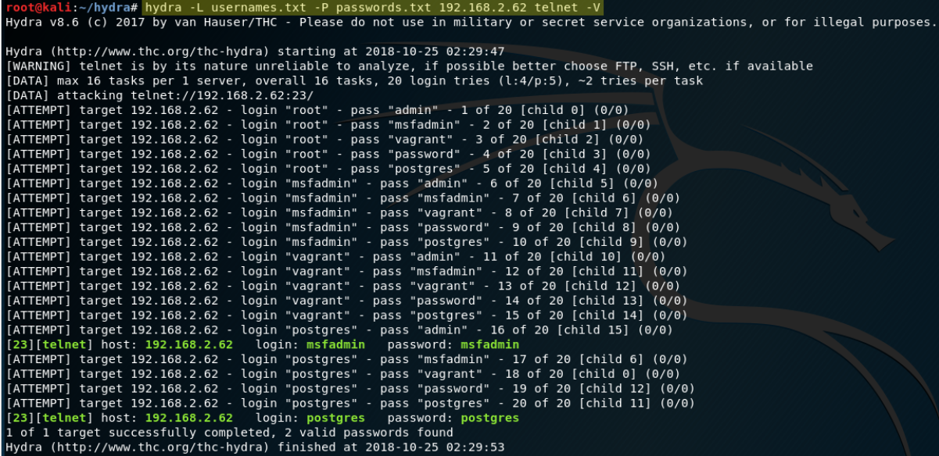
[1] Using hydra to obtain "telnet" login credential

Slide 58
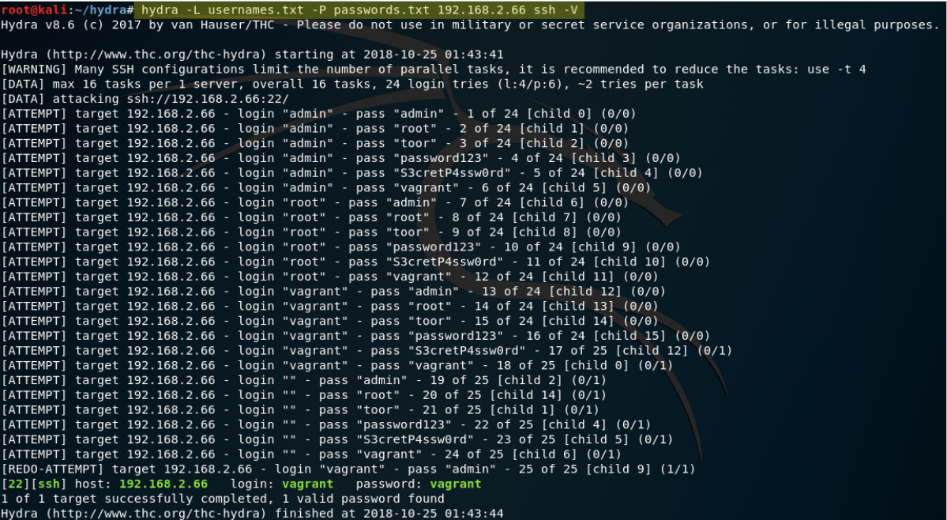
[2] Use hydra to obtain "ssh" login credential

Slide 59
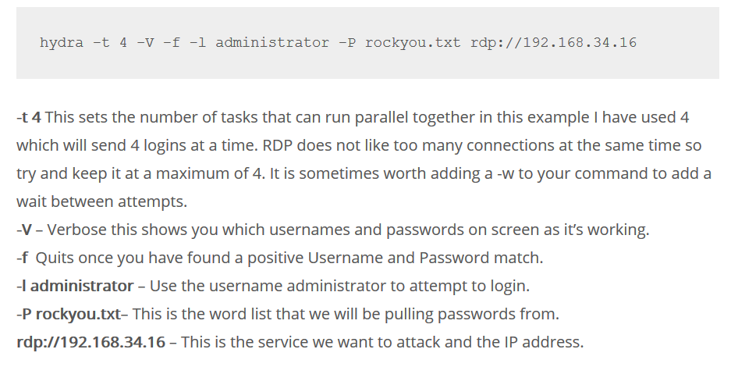
[3] Use hydra to obtain "rdp" login credential
source: https://securitytutorials.co.uk/brute-forcing-passwords-with-thc-hydra/

Slide 60
Pen-Test Network Firewall

Slide 61
Reasons for Pen-Test Network Firewall
[1] To check access to the Network Firewall via the Web Interface
Using the normal web interface provided by the Firewall and login to the Firewall, the pen-tester will have all the log on the traffic flowing in and out of the network. The pen-tester will also have access to the firewall rules.
[2] To check access to the Network Firewall via services such as telnet, ssh and rdp.
All these services allow the administrator to remote access into the Firewall to maintain the device. Similar to [1], the pen-tester will gain insight to the traffic logs and firewall rules.

Slide 62
Methods for obtaining Network Firewall Access through Web Interface

Slide 63
The problems are similar to those mentioned in wireless router and network router. There may be more port available for access.

Slide 64
Activity 4.3 - Exploration
Open a copy of Palo Alto - VM50 issued to you (for NS class) and scan for port 80 or similar ports for http protocol.
Open the web access using your browser in Kali Linux and explore the chances of breaking in.
No submission needed.

Slide 65
Methods for obtaining Network Firewall Access through Remote Access Services

Slide 66
The problems are similar to those mentioned in wireless router and network router. There may be more ports available for access.

Slide 67
Activity 4.4 - Exploration
Work in team of 2.
Use the same Palo Alto - VM50 issued to you (for NS class) and scan for open ports and look out for port 3389, 22 and 23.
Demonstrate that you can use hydra or other similar bruit forcing tools to break in ONE of these ports.
Document the steps and submit to your class's team folder.
Name the file Act4.4-Names.
Complete before week 6.

Slide 68
Summary

Slide 69
Summary
Activities in Scanning Phase
Network Perimeter and Network Perimeter Devices
Scanning for Network Perimeter Devices
Choice of Entry Points
Pen-Test Wireless Router
Methods for obtaining Wireless Network Access through Encryption Keys
Methods for obtaining Wireless Router Access through Web Interface
Methods for obtaining Wireless Router access through Remote Access Services
Pen-Test Network Router
Methods for obtaining Network Router Access through Web Interface
Methods for obtaining Network Router access through Remote Access Services

Slide 70
Pen-Test Network Firewall
Methods for obtaining Network Firewall Access through Web Interface
Methods for obtaining Network Firewall Access through Remote Access Service

Slide 71
EXTRA
Other hydra-like tools can be found at
https://hackertarget.com/brute-forcing-passwords-with-ncrack-hydra-and-medusa/

Slide 72
Q&A

Slide 73
End

